Slide 1
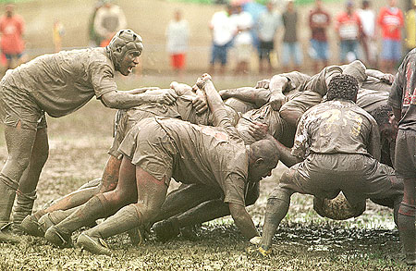
Agile Myths and Lessons Learned
Steven McGee PMP/ACP/CSP/CSM/SPC4/CDA
Steven.mcgee@bcbsla.com
2

Slide 2

“Never let a good crisis go to waste” – Winston Churchill
Many senior managers fear “Agile” because they equate it to “no documentation, anarchy (through self-organizing teams) and cowboy coding practices.”
Hard-core agilistas promote “the code is the documentation” and “we deliver to production every 2 weeks whether the users are ready or not.”
Hard pill in large organizations with diverse stakeholder groups, regulatory/compliance requirements, enterprise architecture standards, hundreds of interconnecting systems and ITIL based production support

Slide 3
What Does it mean?
A-gil-i-ty (ә-'ji-lә-tē) Property consisting of quickness, lightness, and ease of movement; To be very nimble
The ability to create and respond to change in order to profit in a turbulent business environment
The ability to quickly reprioritize use of resources when requirements, technology, and knowledge shift
A very fast response to sudden market changes and emerging threats by intensive customer interaction
Use of evolutionary, incremental, and iterative delivery to converge on an optimal customer solution
Maximizing BUSINESS VALUE with right sized, just enough, and just-in-time processes and documentation
Highsmith, J. A. (2002). Agile software development ecosystems. Boston, MA: Addison-Wesley.

Slide 4
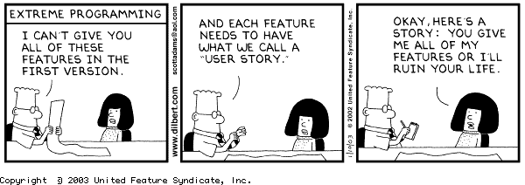

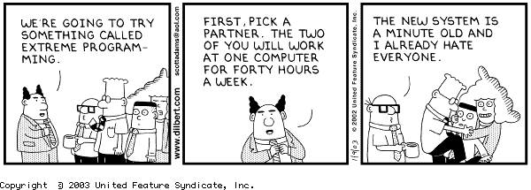
Agile Misconceptions?
Agile means: “letting the programming team do whatever they need to with no project management, and no architecture, allowing a solution to emerge, the programmers will do all the testing necessary with Unit Tests…”

Slide 5

Agile Manifesto-Foundation of Agile Software
Development
Through this work we have come to value:
• Individuals and interactions over processes and
tools
• Working software over comprehensive
documentation
• Customer collaboration over contract negotiation
• Responding to change over following a plan
That is, while there is value in the items on the
right,
we value the items on the left more .
http://www.agilemanifesto.org/
Common myth:
The manifesto is
often misinterpreted
to mean
no documentation,
no process, and
no plan!
20

Slide 6
Agile Principles Accompanying the Manifesto 1 –
All are important aspects of building an agile culture
1.
2.
3.
4.
5.
6.
Highest priority is satisfy the customer through early and continuous
delivery of software.
Welcome changing requirements, even late in development…
Deliver working software frequently, from a couple of weeks to a
couple of months...
Business people and developers must work together daily
throughout the project.
Build projects around motivated individuals. Provide environment
and support they need…
The most efficient and effective method of conveying information to
and within a development team is face-to-face conversation.

Slide 7
Agile Principles Accompanying the Manifesto 2 –
All are important aspects of building an agile culture
7.
8.
9.
10.
11.
12.
Working software is the primary measure of progress.
Agile processes promote sustainable development…a constant
pace indefinitely.
Continuous attention to technical excellence and good design
enhances agility.
Simplicity--the art of maximizing the amount of work not done--is
essential.
The best architectures, requirements, and designs emerge from
self-organizing teams.
At regular intervals, the team reflects on how to become more
effective, then tunes and adjusts its behavior accordingly.
Adapted from http://agilemanifesto.org/principles.html
22

Slide 8
Exercise
Pair up
Agree on one Agile Myth you have heard
Write on a stickie
Post on wall
I will tell you which we will discuss

Slide 9
Agile Myths

Slide 10
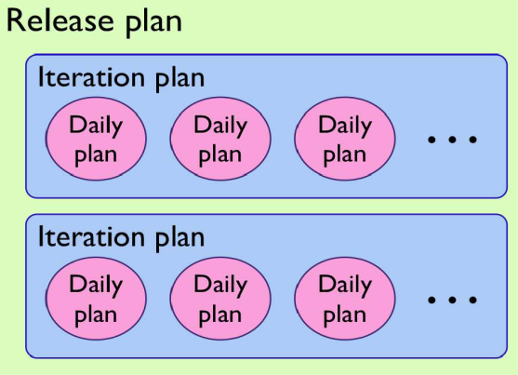

Myth 1: Agile Means No Planning/ Documentation
Actually there are multiple levels of planning
Daily planning
Bi-weekly Sprint planning
Release Planning every 3 – 4 months
Agile does, in fact, produce documentation, even though it differs from that of Waterfall.
Increased collaboration throughout Agile development projects provides all stakeholders with a better understanding of the end product as it is being created, thus reducing the need for some design documentation.
For example, rather than create a single, lengthy document listing all project requirements, project managers might compile a collection of user stories that can be actively updated and maintained using software, prioritized on the fly, and used to provide real-time visibility into development progress.

Slide 11

Myth 2: Agile is a silver bullet solution!
Proponents of agile will sometimes claim that moving to agile will “fix all of your problems”.
That is not the case.
Agile Values and Principles point to Collaboration, Rapid Feedback Loops, and Quality.
In this way, agile exposes your problems - before any issue can be addressed, it needs to be surfaced.

Slide 12

Myth 3: Agile Projects don’t use Project Managers
It is true Scrum doesn’t discuss Project Managers – it focuses on the Product Owner, Scrum Master, and the Development Team.
Project Managers typically have different responsibilities, such as budgeting, reporting, and portfolio management.
In projects using Scrum, these tasks are often split up between the product owner and scrum master.
Project Managers will often take the scrum master role and then train the product owners

Slide 13
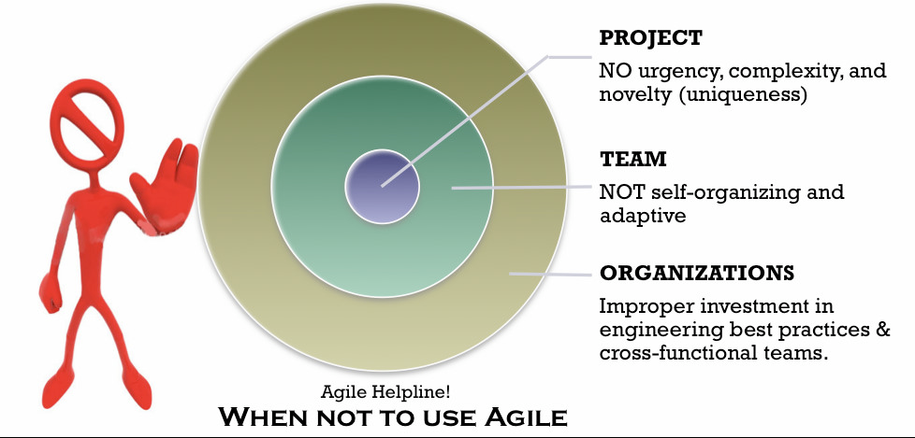
Myth 4: Agile can be used for all/any software development
Not recommended for systems where human life is on the line.
NASA

Slide 14
Myth 5: Agile = Anarchy
Some managers believe that self-organization is the same as anarchy
A self organized team is a group of motivated individuals, who manage their work (allocation, reallocation, estimation,, delivery, and rework) as a group.
They still require mentoring and coaching, but they don't require "command and control."
Management role does change
They provide care and feeding
They define clear vision and constraints
Not responsible for delivery
It is only within this confines does self-organization happen

Slide 15
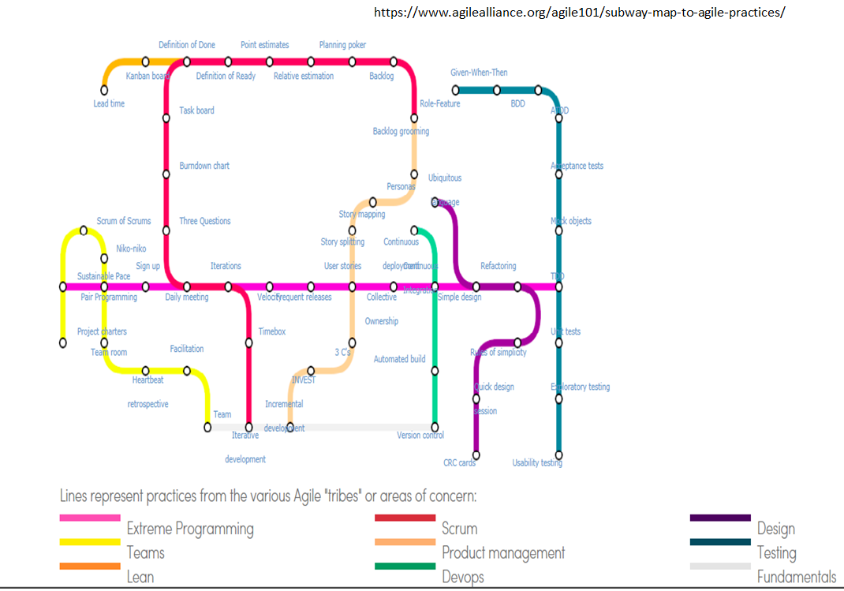
Myth 6: There’s only one way to do Agile
The Agile Manifesto consists of four values and 12 principles.
Each style has benefits, as well as weaknesses, and one must evaluate their own specific situation to determine which interpretation is the best match.
As long as you are adhering to the Agile Manifesto’s values and principles, you should be considered agile.

Slide 16
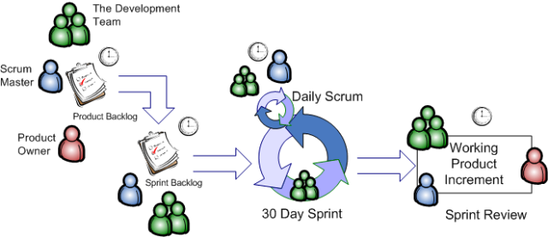
Myth 7: Agile processes are less disciplined and structured than those of waterfall.
Successful Agile implementations are more process-driven and coordinated than traditional waterfall implementations.

Slide 17
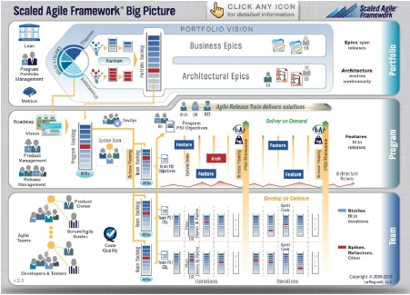
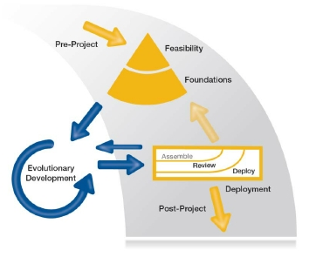
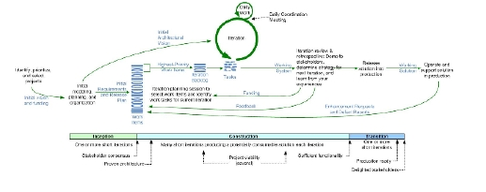
Myth 8: Agile only works for small projects….
DSDM
www.dsdm.org
SAFe
www.scaledagileframework.com
DAD
https://www.ibm.com/developerworks/community/blogs/ambler/entry/dis
ciplined_agile_delivery_dad_lifecycle14?lang=en
33

Slide 18
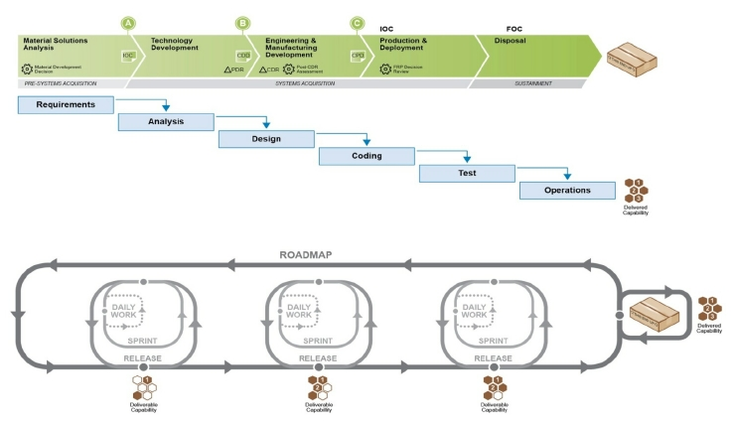
Myth 9: Agile is just incremental, or spiral, or
iterative, renamed
Fixed Vision
Evolving Vision
Source: Palmquist, Steven; Lapham, Mary Ann; Garcia-Miller, Suzanne; Chick, Timothy; & Ozkaya, Ipek. Parallel Worlds: Agile and Waterfall Differences and Similarities
(CMU/SEI-2013-TN-021). Software Engineering Institute, Carnegie Mellon University, 2013.
.

Slide 19
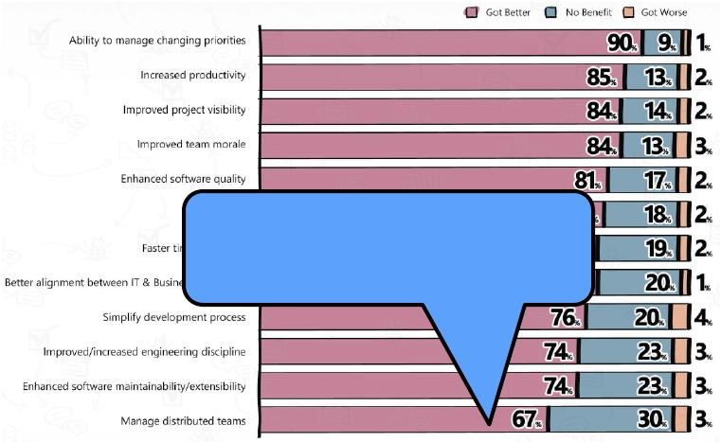
Myth 10: Agile Only Works in Co-Located
Environments
67% of Version One survey
respondents say managing
distributed teams was better when
using Agile.

Slide 20
Agile Lessons Learned

Slide 21
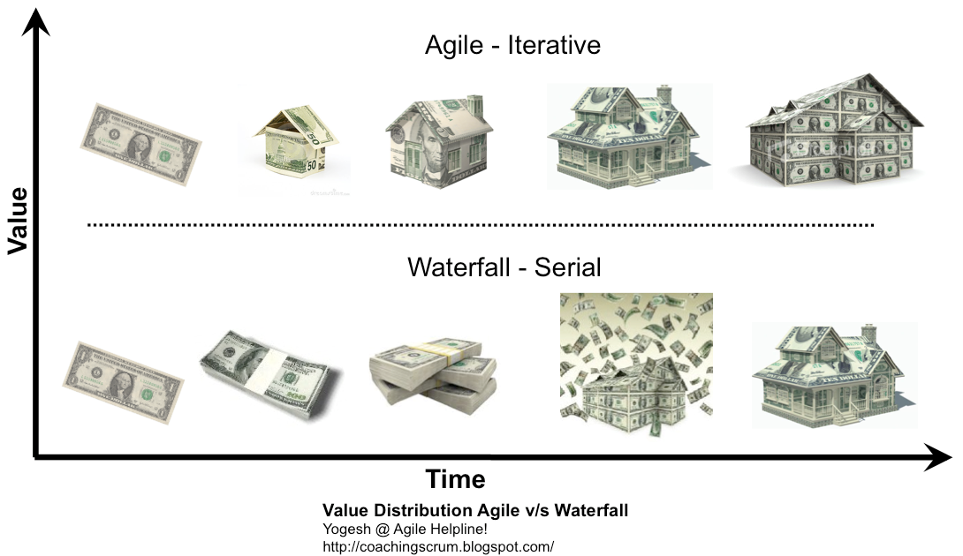
Lessons Learned: Agile Value Proposition

Slide 22
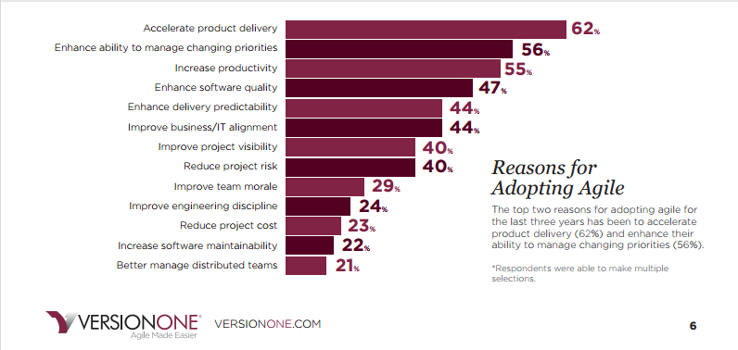
Lessons Learned: Reasons

Slide 23
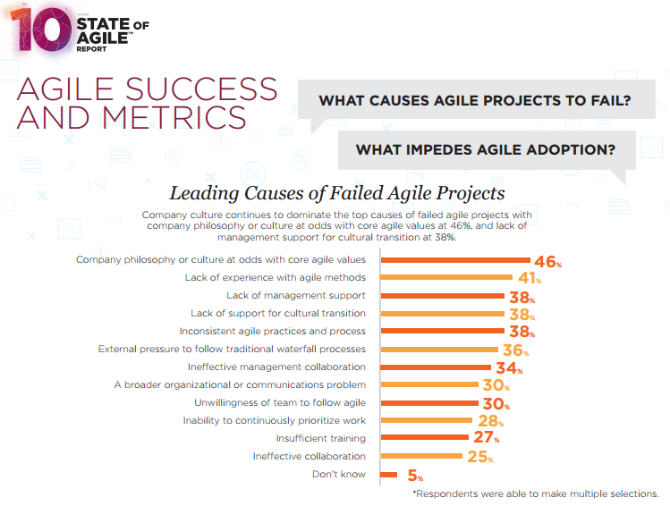
Lessons learned: Causes of Failure

Slide 24
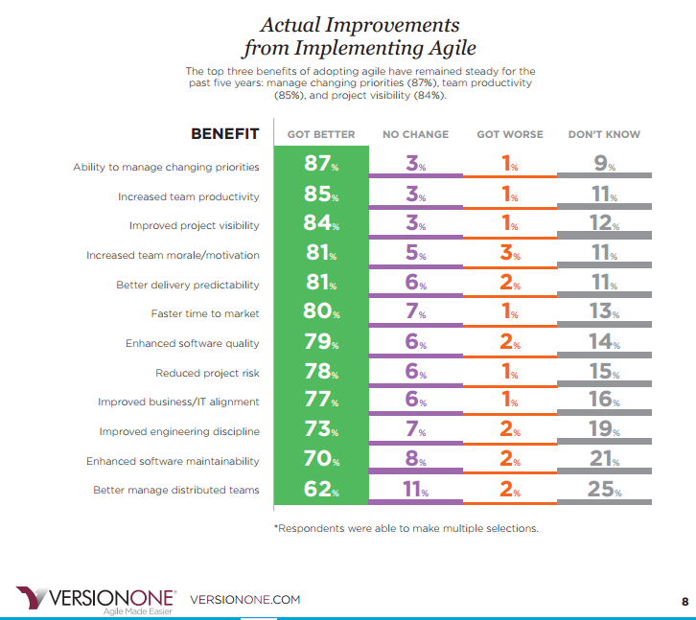
Lessons Learned: Improvements

Slide 25
Summary
Like all myths, Agile myths usually are based on some actual
Experience
• Sometimes anomalous
• Often happens when teams who are trying to mimic Agile practices without
understanding Agile principles fail in some way
We have seen counter examples FOR ALL THESE MYTHS
• Agile isn’t always the answer to a software development’s problems, but these
myths shouldn’t be a reason to avoid it

Slide 26
Questions?

